Slide 1

CUNY 602 Final Project Analysis of Election Voters vs Non-Voters
Jennifer Abinette

Slide 2
Agenda
Abstract of no more than 300 words.
Introduction - research question clearly stated, can be answered by the data
EDA - well-labeled graphs/plots that are appropriate to your analysis. Each visualization includes a description of what is being shown.
Data Wrangling - tidying of your data, manipulating missing values, structuring of your data, etc.
Data Analysis.
Conclusions

Slide 3
Abstract
According to the U.S. Census Bureau, 66.8% of citizens over 17 voted in the 2020 presidential election which can boast the highest voter turnout in the 21st century. Using data published online on fivethirtyeight, we explore the characteristics of voter frequency and further analyze participants planning to vote in the 2020 November election. We found that of those voting in 2020 election, participants that in the past have rarely/never voted are younger, perceived voting to be more difficult, experienced more barriers to voting and believe the 2020 election results to be less important.

Slide 4
Research Question
What characterizes a nonvoter vs someone who always votes?

Slide 5
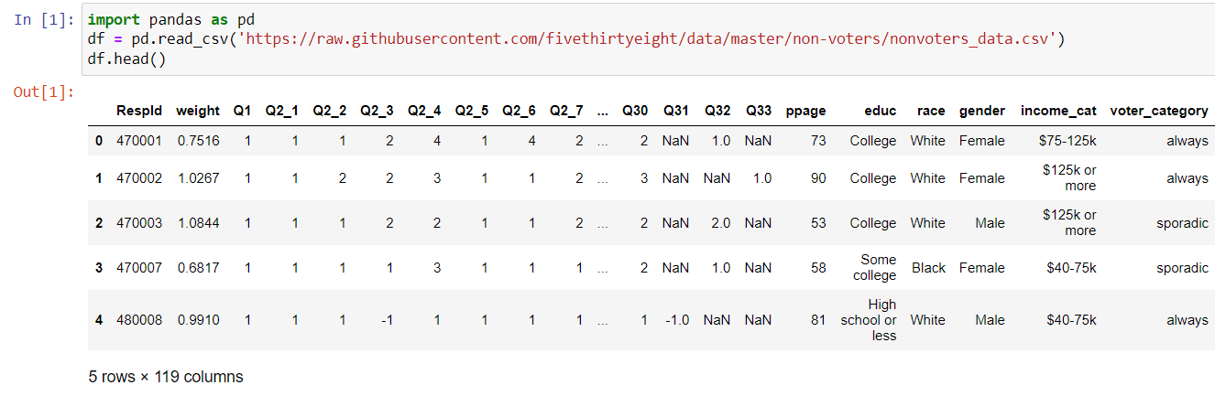
Exploratory Data Analysis
https://github.com/fivethirtyeight/data/tree/master/non-voters
Link to Data Dictionary:
https://github.com/fivethirtyeight/data/blob/master/non-voters/nonvoters_codebook.pdf

Slide 6
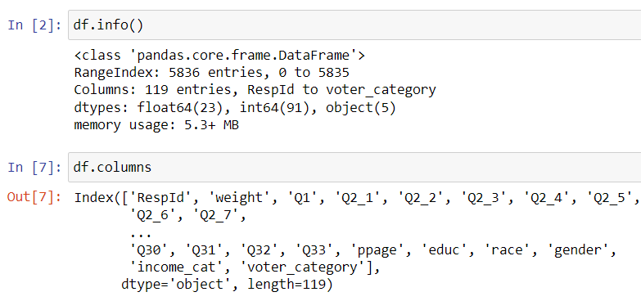
Dataset includes 5836 cases (rows) and 119 variables (columns) with most questions answered on a scale of 1-4.

Slide 7
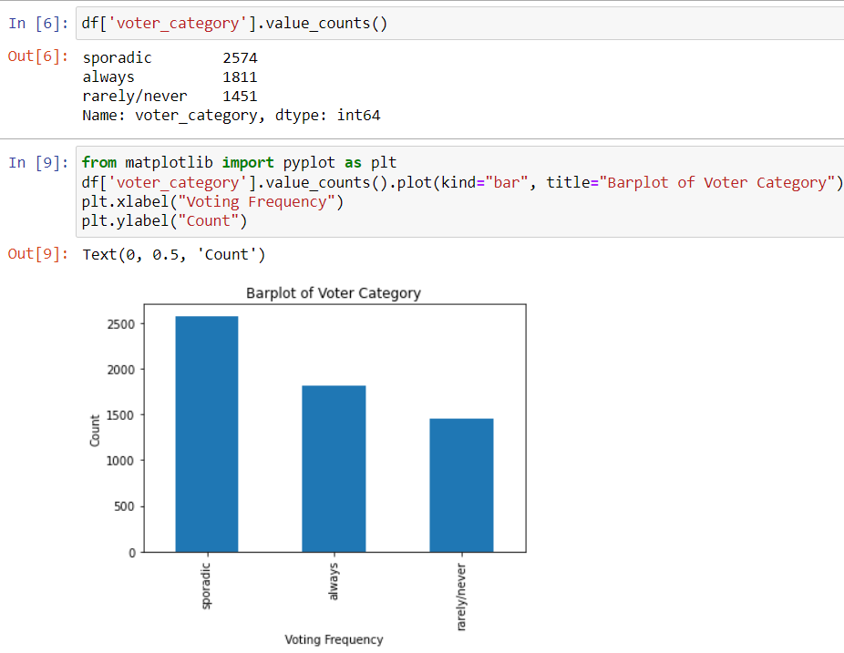

Slide 8
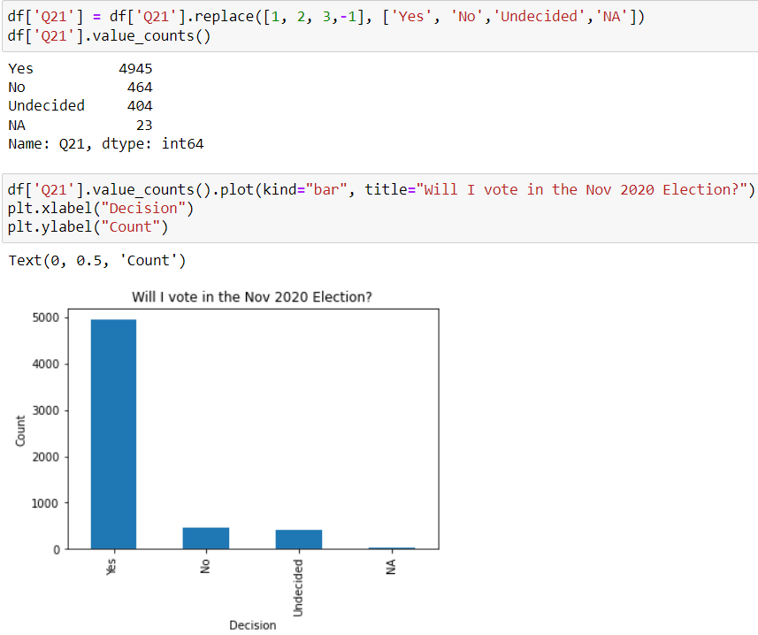

Slide 9
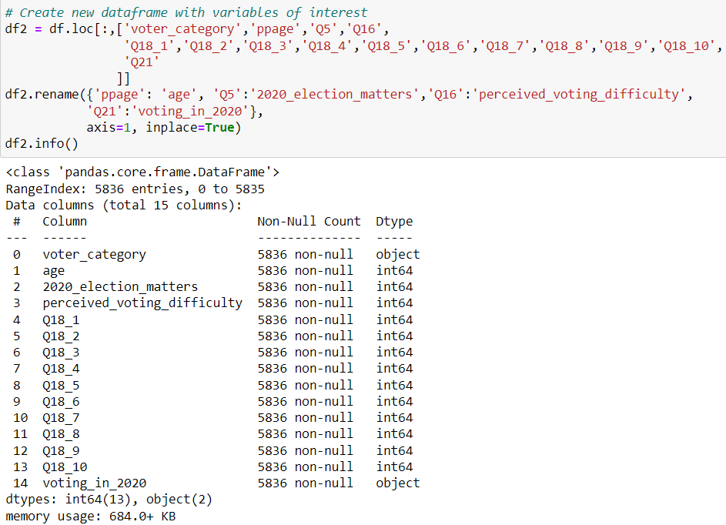
Data Wrangling

Slide 10
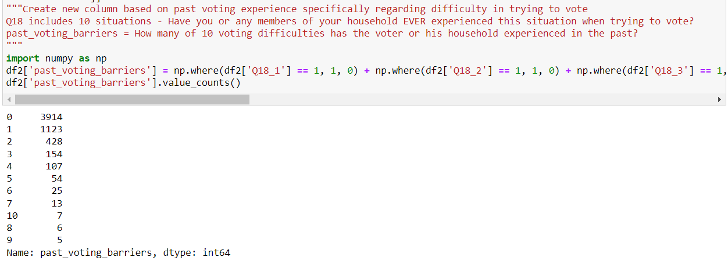
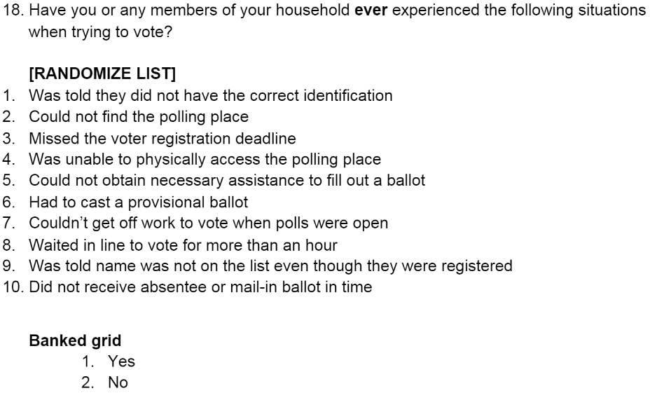
Experienced Voting Difficulties in Past

Slide 11
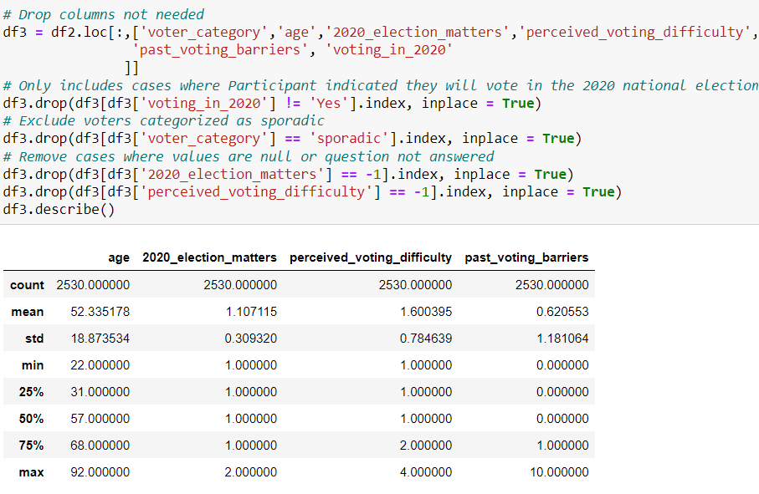
Analysis of Cases that will vote in Nov 2020 Election

Slide 12
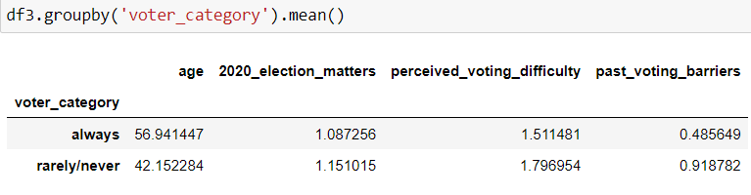
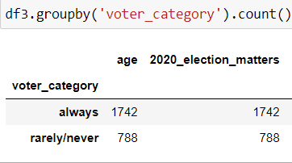
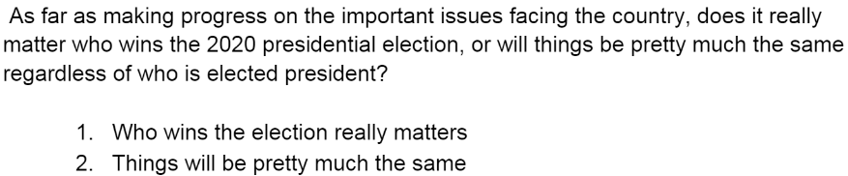
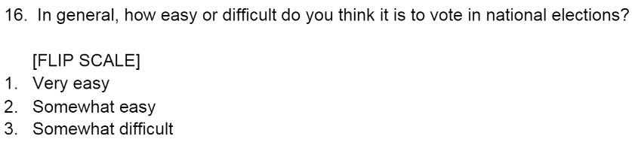
Past Voting Frequency
2020_Election_Matters
Perceived_Voting_Difficulty

Slide 13
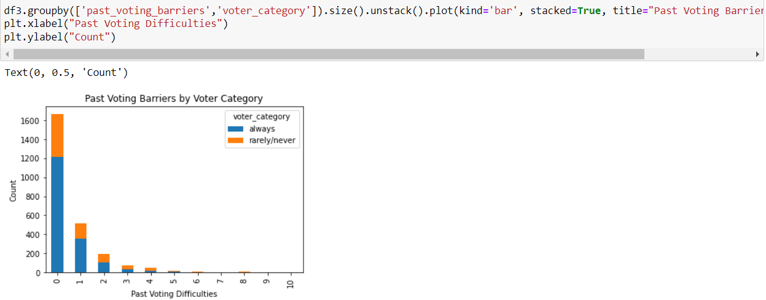
Past Voting Barriers

Slide 14
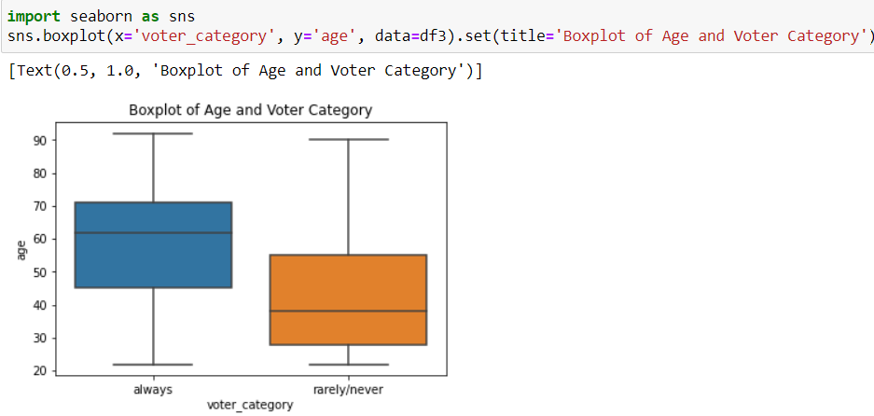
Age

Slide 15
Conclusions
2530 of 5836 participants plan to vote in the 2020 Nov. Election
On average, the 788 that rarely/never vote compared to the 1742 that always vote are:
Younger (mean of 42 vs 57 years)
Perceived voting to be more difficult (mean of 1.8 vs 1.5)
Experienced more and varied past voting barriers (mean of .92 vs .49)
Believe that who wins the 2020 election matters less (mean of 1.15 vs 1.09)

Slide 16
Thank You!

